Slide 1
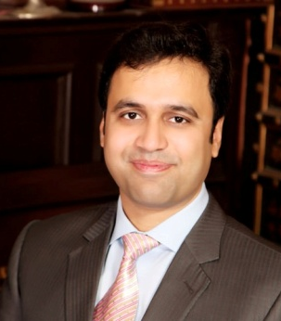
Introduction to Accreditation life cycle & stakeholders management M Adil A Kazi
Dr. Kumail Rizvi Associate Professor
M Adil A Kazi Asstt. Professor

Slide 2
Introduction to Accreditation life cycle & stakeholders management
NO
Yes
1- Formal Application
3- Eligibility Screening
4- Pre-Review Mentorship
5-Self Assessment Process
6-Peer Review Process
7-Accreditation Decision
2- Pre-Eligibility Mentorship
8-Continuous Review (Re-accreditation/ Revisit
NBEAC ACCREDITATION FRAMEWORK
NBEAC Accreditation 8-Stages Process
Formal Application
Pre Eligibility Mentorship
Eligibility Screening
Pre Review Mentorship
Self-Assessment Process
Peer Review Process
Accreditation Decision
Continuous Review (Reaccreditation / Accreditation)

Slide 3
Introduction to Accreditation life cycle & stakeholders management
NO
Yes
1- Formal Application
3- Eligibility Screening
4- Pre-Review Mentorship
5-Self Assessment Process
6-Peer Review Process
7-Accreditation Decision
2- Pre-Eligibility Mentorship
8-Continuous Review (Re-accreditation/ Revisit
NBEAC ACCREDITATION FRAMEWORK
NBEAC Accreditation 8-Stages Process
Formal Application
Online Registration application (http://app.nbeac.org.pk/)
Registration fee of Rs.25,000/(non-refundable)
Basic information Performa:
Strategic Management,
Students, Faculty,
Curriculum and
Linkages etc.

Slide 4
Introduction to Accreditation life cycle & stakeholders management
NO
Yes
1- Formal Application
3- Eligibility Screening
4- Pre-Review Mentorship
5-Self Assessment Process
6-Peer Review Process
7-Accreditation Decision
2- Pre-Eligibility Mentorship
8-Continuous Review (Re-accreditation/ Revisit
NBEAC ACCREDITATION FRAMEWORK
NBEAC Accreditation 8-Stages Process
Formal Application
Pre Eligibility Mentorship
Voluntary activity initiated at the request of the school.
NBEAC Assigning Mentors on ONE day visit to:
guide develop an updated registration & datasheet as per developmental requirements during eligibility screening
interacts with internal stakeholders to share minimum requisites for accreditation.
Prepare and submits report to NBEAC secretariat specifying time required for submission.

Slide 5
Introduction to Accreditation life cycle & stakeholders management
NO
YES
1- Formal Application
3- Eligibility Screening
4- Pre-Review Mentorship
5-Self Assessment Process
6-Peer Review Process
7-Accreditation Decision
2- Pre-Eligibility Mentorship
8-Continuous Review (Re-accreditation/ Revisit
NBEAC ACCREDITATION FRAMEWORK
NBEAC Accreditation 8-Stages Process
Formal Application
Pre Eligibility Mentorship
Eligibility Screening
Submission of Registration application one month before Eligibility Screening Committee (ESC)
ESC to review basic eligibility screening criteria:
Number of graduated batches
Mission and vision statement
Strategic plan
Faculty & course load(s)
Student to IT & Teacher ratios
Initial Eligibility Screening (IES) letter:
YES- Timeline to submit Self-Assessment Report (SAR)
NO- Pre Eligibility Mentorship offered for resubmission (06-12 months)

Slide 6
Introduction to Accreditation life cycle & stakeholders management
NO
Yes
1- Formal Application
3- Eligibility Screening
4- Pre-Review Mentorship
5-Self Assessment Process
6-Peer Review Process
7-Accreditation Decision
2- Pre-Eligibility Mentorship
8-Continuous Review (Re-accreditation/ Revisit
NBEAC ACCREDITATION FRAMEWORK
NBEAC Accreditation 8-Stages Process
Formal Application
Pre Eligibility Mentorship
Eligibility Screening
Pre Review Mentorship
Voluntary activity initiated at the request of the school.
NBEAC Assigning Team of 1-2 Mentors on ONE day visit to:
Review & examine /cross-check the content and referencing in SAR identifying gaps & suggesting necessary improvements before submission.
interacts with internal stakeholders to share minimum requisites for accreditation.
Prepare and submits report to NBEAC secretariat specifying time required for submission, recommend conducting Peer Review Visit

Slide 7
Introduction to Accreditation life cycle & stakeholders management
NO
Yes
1- Formal Application
3- Eligibility Screening
4- Pre-Review Mentorship
5-Self Assessment Process
6-Peer Review Process
7-Accreditation Decision
2- Pre-Eligibility Mentorship
8-Continuous Review (Re-accreditation/ Revisit
NBEAC ACCREDITATION FRAMEWORK
NBEAC Accreditation 8-Stages Process
Formal Application
Pre Eligibility Mentorship
Eligibility Screening
Pre Review Mentorship
Self-Assessment Process
This process expected commencement time 8-12 weeks (w.e.f. issuance date of IES Letter)
The Business School may/must:
make enquiries/ communication with mentor(s)/ NBEAC secretariat
complete SAR (one hardcopy with supporting documents) be submitted to NBEAC along with accreditation fee (PKR 250,000 per Program).
Remaining 5 sets of SAR hardcopies to be submitted upon receiving explicit consent of acceptance from NBEAC

Slide 8
Introduction to Accreditation life cycle & stakeholders management
NO
Yes
1- Formal Application
3- Eligibility Screening
4- Pre-Review Mentorship
5-Self Assessment Process
6-Peer Review Process
7-Accreditation Decision
2- Pre-Eligibility Mentorship
8-Continuous Review (Re-accreditation/ Revisit
NBEAC ACCREDITATION FRAMEWORK
NBEAC Accreditation 8-Stages Process
Formal Application
Pre Eligibility Mentorship
Eligibility Screening
Pre Review Mentorship
Self-Assessment Process
Consultative Committee will nominate a Peer Review panel (hereinafter called PRT) through NBEAC secretariat.
PRT composition:
Lead Evaluator (Chairperson-PRT) 5-6 Subject Experts-
Chairperson-PRT (Senior experienced national/international accreditation process resource
Tow Subject Experts (Knowledge of accreditation policies, procedures and extensive field
One Corporate Representative
One NBEAC secretariat representative

Slide 9
Introduction to Accreditation life cycle & stakeholders management
NO
Yes
1- Formal Application
3- Eligibility Screening
4- Pre-Review Mentorship
5-Self Assessment Process
6-Peer Review Process
7-Accreditation Decision
2- Pre-Eligibility Mentorship
8-Continuous Review (Re-accreditation/ Revisit
NBEAC ACCREDITATION FRAMEWORK
NBEAC Accreditation 8-Stages Process
Formal Application
Pre Eligibility Mentorship
Eligibility Screening
Pre Review Mentorship
Self-Assessment Process
Peer Review Process
3 days peer review proposed visit schedule shared with the PRT prior to the visit.
Upon completion of formal sessions, the PRT:
meets to finalize the briefing to the stakeholders on day 3
Chairperson- PRT presents verbal feedback of assessment process to the school.
shares findings, deficiencies and recommendations

Slide 10
Introduction to Accreditation life cycle & stakeholders management
NO
Yes
1- Formal Application
3- Eligibility Screening
4- Pre-Review Mentorship
5-Self Assessment Process
6-Peer Review Process
7-Accreditation Decision
2- Pre-Eligibility Mentorship
8-Continuous Review (Re-accreditation/ Revisit
NBEAC ACCREDITATION FRAMEWORK
NBEAC Accreditation 8-Stages Process
Formal Application
Pre Eligibility Mentorship
Eligibility Screening
Pre Review Mentorship
Self-Assessment Process
Peer Review Process
Accreditation Decision
Submitted PRT report after secretarial desk review – submitted to Accreditation Award Committee (AAC)
AAC either:
Endorse recommendation (agreement with recommendations of the PRT)
Provisional recommendation (approval after completing changes in the language or consistency of the report, but no changes in recommendations of the PRT) or

Slide 11
Introduction to Accreditation life cycle & stakeholders management
NO
Yes
1- Formal Application
3- Eligibility Screening
4- Pre-Review Mentorship
5-Self Assessment Process
6-Peer Review Process
7-Accreditation Decision
2- Pre-Eligibility Mentorship
8-Continuous Review (Re-accreditation/ Revisit
NBEAC ACCREDITATION FRAMEWORK
NBEAC Accreditation 8-Stages Process
Formal Application
Pre Eligibility Mentorship
Eligibility Screening
Pre Review Mentorship
Self-Assessment Process
Peer Review Process
Accreditation Decision
Submitted PRT report after secretarial desk review – submitted to Accreditation Award Committee (AAC)
AAC either:
Revise recommendation (recommend changes in the language or consistency of the report and/or endorse revision in the PRT recommendations).

Slide 12
Introduction to Accreditation life cycle & stakeholders management
NO
Yes
1- Formal Application
3- Eligibility Screening
4- Pre-Review Mentorship
5-Self Assessment Process
6-Peer Review Process
7-Accreditation Decision
2- Pre-Eligibility Mentorship
8-Continuous Review (Re-accreditation/ Revisit
NBEAC ACCREDITATION FRAMEWORK
NBEAC Accreditation 8-Stages Process
Formal Application
Pre Eligibility Mentorship
Eligibility Screening
Pre Review Mentorship
Self-Assessment Process
Peer Review Process
Accreditation Decision
The NBEAC secretariat:
works with Chairperson- PRT to incorporate the recommendations of AAC
shares final/ reviewed PRT report with the business school in case of full or provisional recommendation
Submits feedback from business school to AAC after final working with Chairman PRT

Slide 13
Introduction to Accreditation life cycle & stakeholders management
NO
Yes
1- Formal Application
3- Eligibility Screening
4- Pre-Review Mentorship
5-Self Assessment Process
6-Peer Review Process
7-Accreditation Decision
2- Pre-Eligibility Mentorship
8-Continuous Review (Re-accreditation/ Revisit
NBEAC ACCREDITATION FRAMEWORK
NBEAC Accreditation 8-Stages Process
Formal Application
Pre Eligibility Mentorship
Eligibility Screening
Pre Review Mentorship
Self-Assessment Process
Peer Review Process
Accreditation Decision
The NBEAC secretariat:
The Chair of AAC approves the final report to ensure compliance of AAC decision followed by Council for endorsement. There will be four types of accreditation decisions:
05 years, W 80% or above
03 years, X 65%- 79%
Not qualified for accreditation, Y less than 65%

Slide 14
Introduction to Accreditation life cycle & stakeholders management
NO
Yes
1- Formal Application
3- Eligibility Screening
4- Pre-Review Mentorship
5-Self Assessment Process
6-Peer Review Process
7-Accreditation Decision
2- Pre-Eligibility Mentorship
8-Continuous Review (Re-accreditation/ Revisit
NBEAC ACCREDITATION FRAMEWORK
NBEAC Accreditation 8-Stages Process
Formal Application
Pre Eligibility Mentorship
Eligibility Screening
Pre Review Mentorship
Self-Assessment Process
Peer Review Process
Accreditation Decision
The NBEAC secretariat:
The Chair of AAC approves the final report to ensure compliance of AAC decision followed by Council for endorsement. There will be four types of accreditation decisions:
Accreditation Withdrawal- the school can reapply for eligibility after 02 years from the date of withdrawal.

Slide 15
Introduction to Accreditation life cycle & stakeholders management
NO
Yes
1- Formal Application
3- Eligibility Screening
4- Pre-Review Mentorship
5-Self Assessment Process
6-Peer Review Process
7-Accreditation Decision
2- Pre-Eligibility Mentorship
8-Continuous Review (Re-accreditation/ Revisit
NBEAC ACCREDITATION FRAMEWORK
NBEAC Accreditation 8-Stages Process
Formal Application
Pre Eligibility Mentorship
Eligibility Screening
Pre Review Mentorship
Self-Assessment Process
Peer Review Process
Accreditation Decision
Continuous Review (Reaccreditation / Revisit)
The NBEAC accreditation process enters into “Re-accreditation/ Revisit process cycle” as continuous function after completion of the PRT visit or accreditation award.
This embeds a dynamic function of continuous review process configuring Quality Enhancement regime to improve standards before the re-accreditation visit.

Slide 16
Introduction to Accreditation life cycle & stakeholders management
STAKEHOLDERS MANAGEMENT
Portfolio
Program
Project

Slide 17
Introduction to Accreditation life cycle & stakeholders management
STAKEHOLDERS MANAGEMENT
“A stakeholder in an organization is any group or individual who can affect or is affected by the achievement of the organization’s objectives. (Freedman, 1984, p. 4)
Introductions
Stakeholder Identification
Stakeholder Engagement
Continuous involvement
Guidelines for Success
Parting Thoughts
STAKEHOLDER: “An individual or group of individuals (organizations) who has an interest in the program and can influence or be influenced by its process and/ or outcomes”

Slide 18
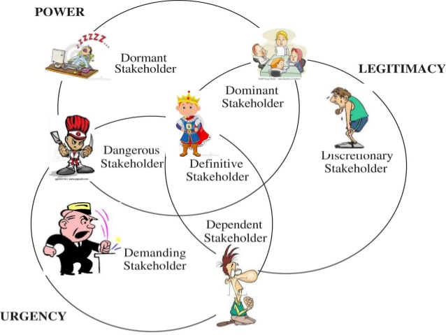
Introduction to Accreditation life cycle & stakeholders management
STAKEHOLDERS MANAGEMENT
Salience Model

Slide 19
Introduction to Accreditation life cycle & stakeholders management
STAKEHOLDERS MANAGEMENT
Stakeholder Analysis Stakeholder analysis helps in identifying key stakeholders and information about them such as:
Stakeholder | Organization or Affiliation | Project Role | Unique Facts | Level of Interest | Level of Influence | Suggestions for Managing the Relationship
Meeting or exceeding stakeholder needs and expectations invariably involves balancing competing demands among:
Stakeholders with differing needs and expectations
Identified needs and unidentified expectations - “client relations challenge”

Slide 20
Introduction to Accreditation life cycle & stakeholders management
STAKEHOLDERS MANAGEMENT
3 Stakeholder involvement for programme development
Background:
The Higher Education Strategy Groups globally expect that more emphasis should be placed on the development of students’ generic skills within Higher Education, “especially those required for the workplace and for active citizenship”.
The drive in the Higher Education sector for quality assurance, accountability for outcomes and capability of graduates is the locus classicus.

Slide 21
Introduction to Accreditation life cycle & stakeholders management
STAKEHOLDERS MANAGEMENT
3 Stakeholder involvement for programme development
To generate a structure to engage and harness feedback from the various stakeholders of a degree programme to formulate a philosophy for the programme’s future development.
Vision
Staff (Academic, Technical and Management)
Mission
Graduates (the voice of students)
Values
Objectives
Industry (Employers, External Examiners, Accreditation Bodies
The potential always exists to use multidisciplinary groups to plan curricula in an educational environment. The stakeholders to be consulted in the development of these are shown as:
The vision and mission statements for the programme in question are generated by a combination of internal and external stakeholders

Slide 22
Introduction to Accreditation life cycle & stakeholders management
STAKEHOLDERS MANAGEMENT
3 Stakeholder involvement for programme development
A good mission statement aims to define a task clearly and concisely and inspire subsequent efforts. An effective mission statement should address three questions:
What are the opportunities or needs that we seek to address? (purpose of the Programme)
What are we doing to address these needs? (activities of the Programme)
What principles or beliefs guide this work? (values the programme should instill in Faculty / Students)
An overall structure for stakeholder-centred programme development consists of the development of draft mission and vision statements on the basis of staff inputs, followed by evaluation of these statements by the various external stakeholders.

Slide 23
Introduction to Accreditation life cycle & stakeholders management
STAKEHOLDERS MANAGEMENT
3 Stakeholder involvement for programme development
Staff Workshop
Establish Committee/ Composition of Committee Members
Set discourse and obtain data on faculty/ staff perceptions of desired program priorities
Graduate Workshop
Mid-programme graduates (2 – 3 years in case of UG programme)
Employer Interviews
Employers, Experts, External Examiners/ Evaluators/ Accrediting bodies: “What is the difference between the institution’s graduate you have employed/ examined/ evaluated from the graduates of other institutions”?
“What are desired graduate attributes? How to achieve these?
Name skills/ attributes/ knowledge areas in which one particularly feels proficient/ deficient following completion of the program

Slide 24
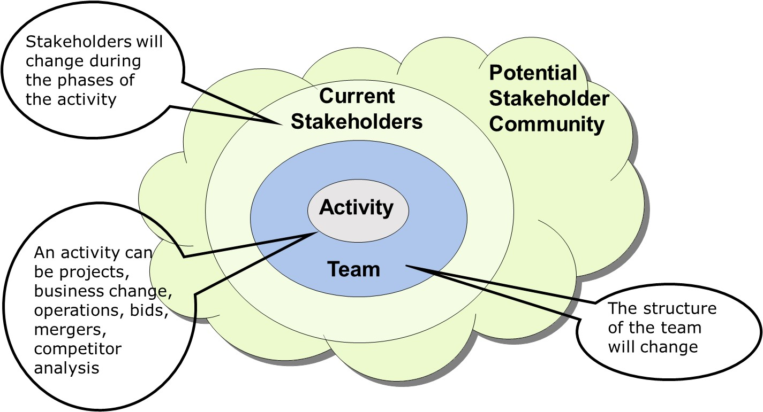
Stakeholder Engagement is Ongoing
Introduction to Accreditation life cycle & stakeholders management
STAKEHOLDERS MANAGEMENT

Slide 25
Stakeholder Engagement is Ongoing
Introduction to Accreditation life cycle & stakeholders management
STAKEHOLDERS MANAGEMENT
Continuous improvement is Ongoing
Constitution and formal establishment of permanent “Accreditation Management Committee”, at School of Business / Management Sciences is a promising strategy to deploy quality function in the institution- (for stakeholder engagement and continues involvement)

